Slide 1

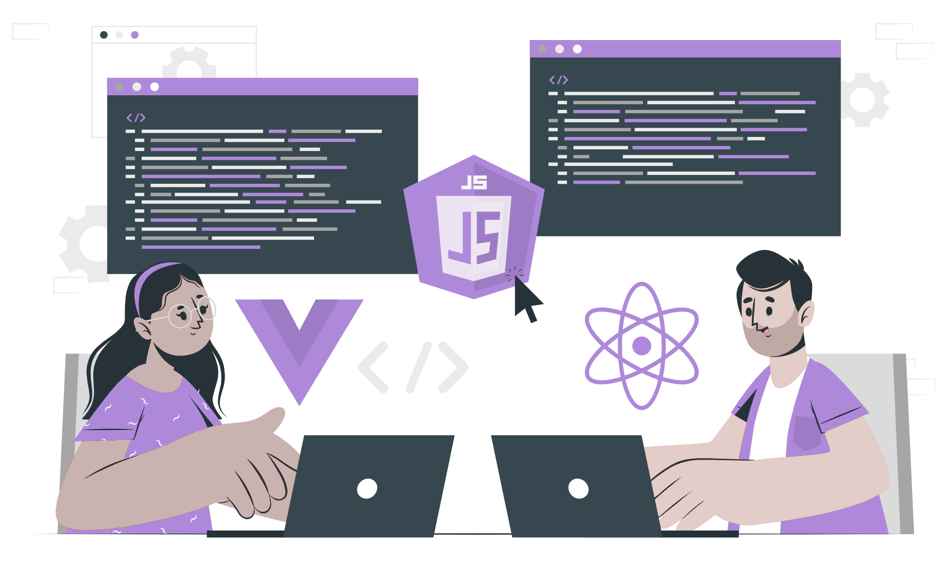
While and Do-while loop

Slide 2
List of content
While loop
Example
Do-while loop
Example

Slide 3
While loop
As we already know, loops are used in programming to repeatedly run a block of code.
A loop can be used, for instance, to repeat a message hundred times.
While loop
Syntax :
do {
// body of loop
} while(condition)

Slide 4
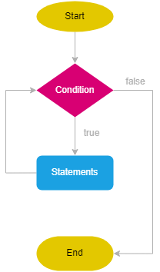
While loop
The parentheses has the condition that is to be evaluated by a while loop ().
The while loop's code is run if the condition evaluates to true.
The condition is assessed again.
until the condition is false, this process keeps going.
The loop ends when the condition is evaluated as false.

Slide 5
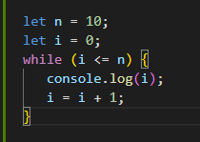
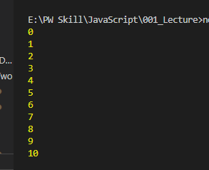
Example 1:
To print numbers from 1 to 10 using while loop

Slide 6
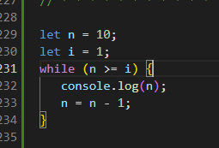
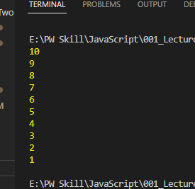
Example 2:
To print numbers from 10 to 1 in decreasing order.

Slide 7
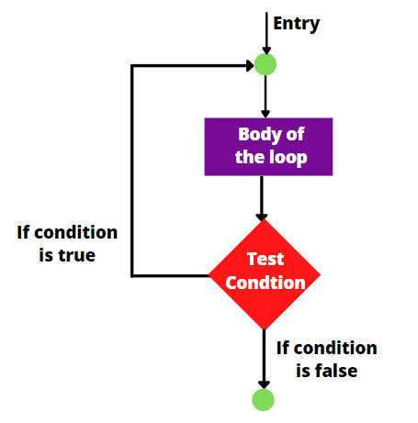
Do-while loop
Syntax :
do {
// body of loop
} while(condition)

Slide 8
Do-while
The loop's body is first executed. The condition is analyzed afterwards.
The body of the loop within the do statement is repeated if the condition evaluates to true.
A second assessment of the condition is made.
The body of the loop within the do statement is repeated again if the condition evaluates to true.
Up until the condition is evaluated as false, this process keeps going. The loop then ends.

Slide 9
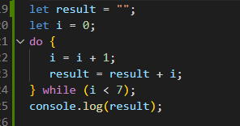

Example:
Write a program to print numbers from 1 to 7 in a line using do-while loop

Slide 10
THANK YOU

